Slide 1
Droplet Parameter Estimation using ML
Project updates

Slide 2
Overview of methodology
Pre-processing raw image data to create a dataset of individual droplet images with annotation
Testing the CNN for its performance
1
3
2
4
Training a CNN on the dataset
Testing the model on raw images to check performance

Slide 3
Dataset Generation & Pre-Processing
Contours were detected on the raw image using OpenCV
Contours were filtered based on various parameters to obtain the ROIs
ROIs were pasted on a 512 x 512 pixel background to create uniform-size training images
Annotation file was created for training labels
The dataset was split into training, validation and testing sets with 10% data in both validation and testing sets,
* For bigger training datasets that included 5 or more than 5 different diameters, only droplets that fell in the 300mm range of focal plane on both sides were included in the training

Slide 4
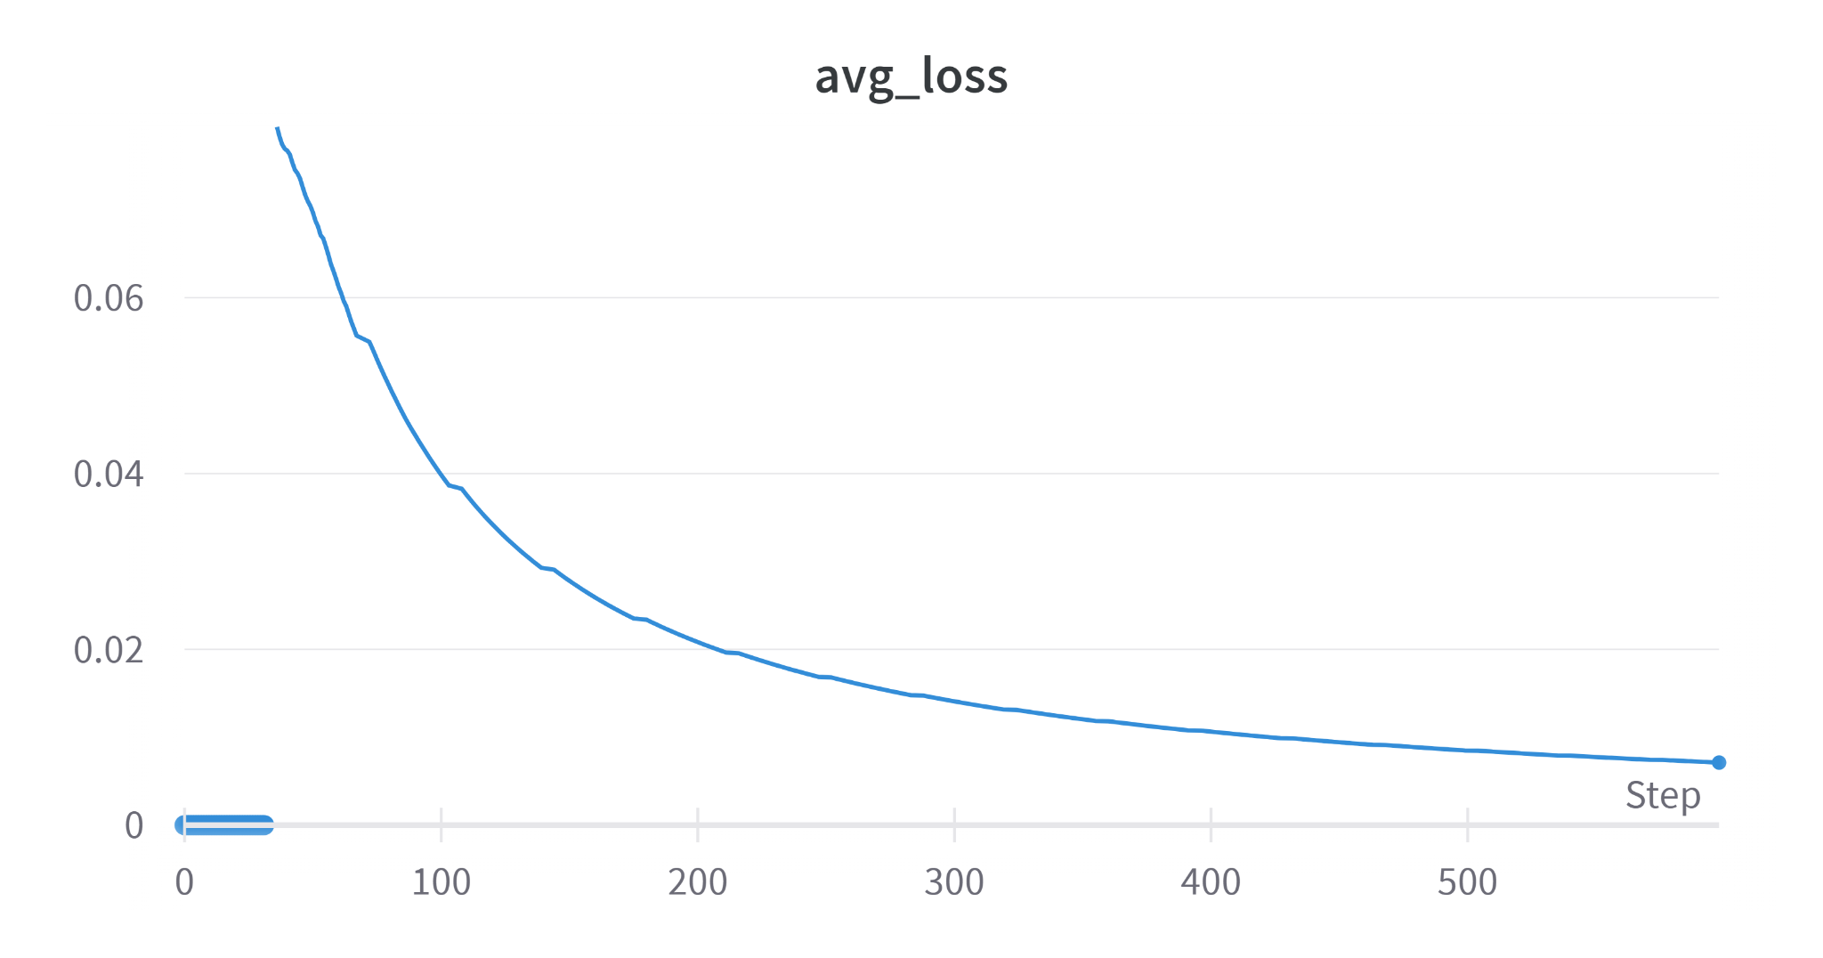
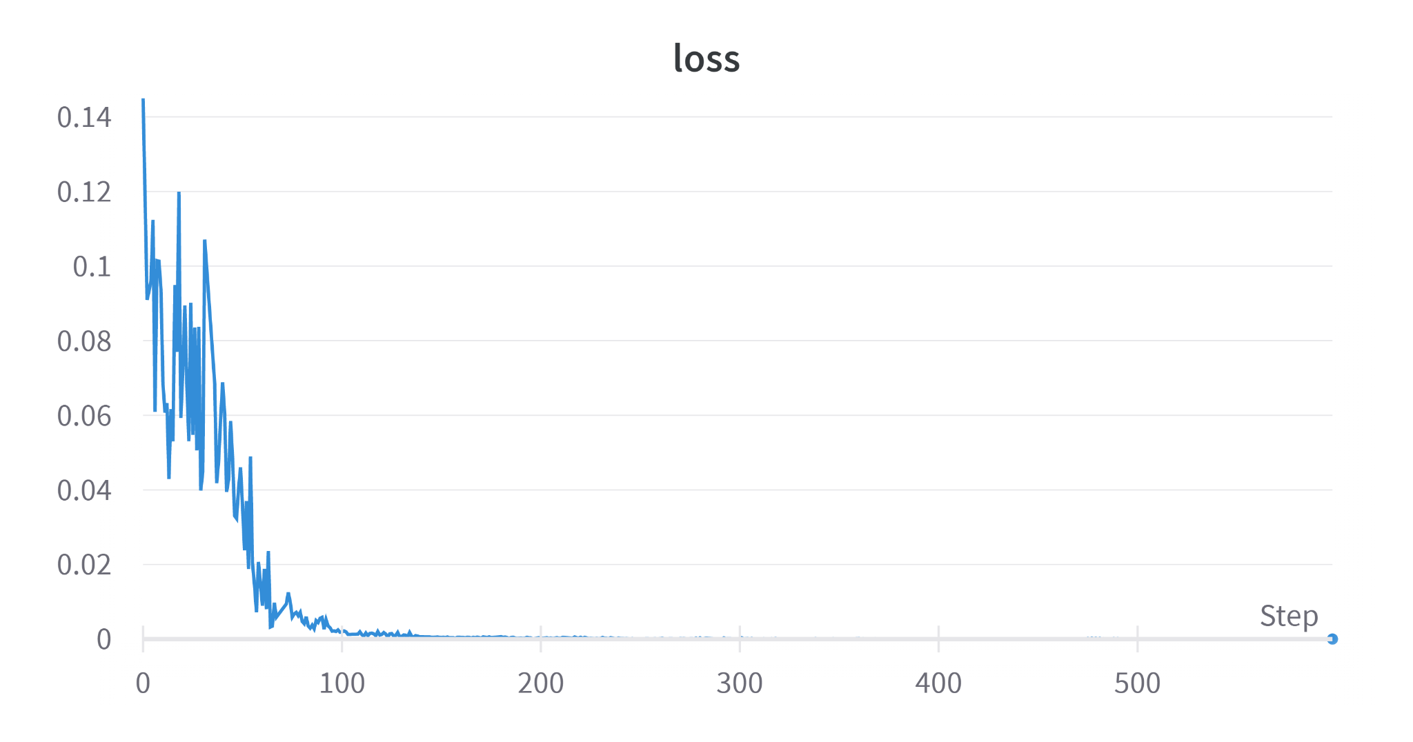
In-focus: All Diameters
Training Graphs

Slide 5
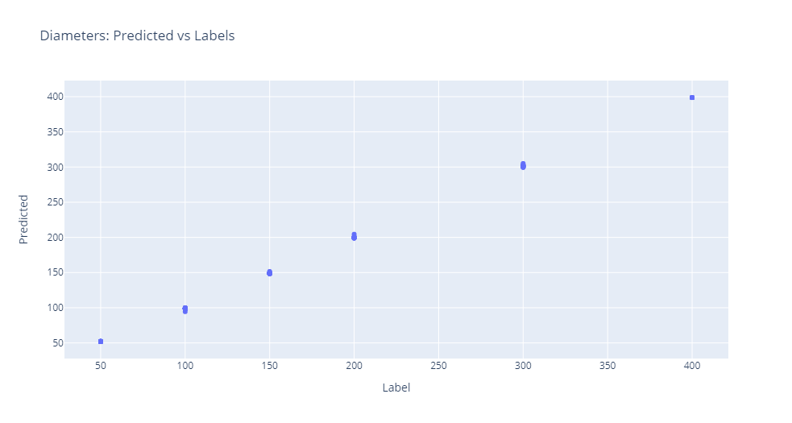

Slide 6
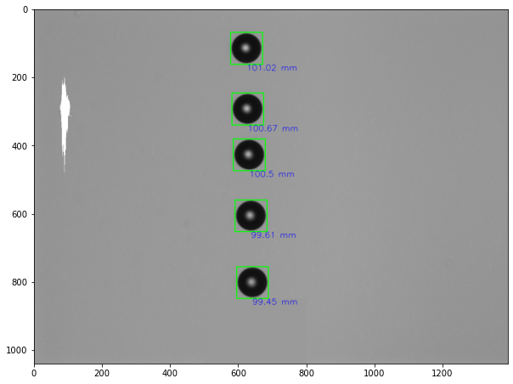
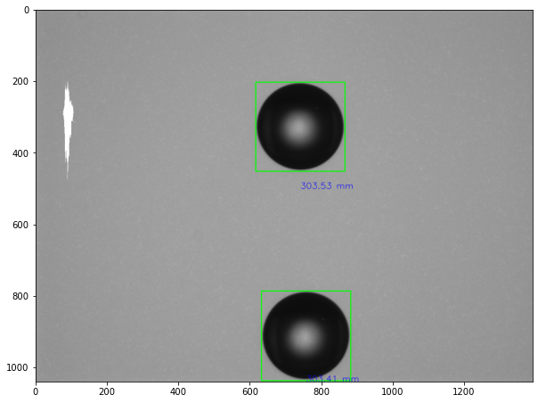
Sample outputs

Slide 7
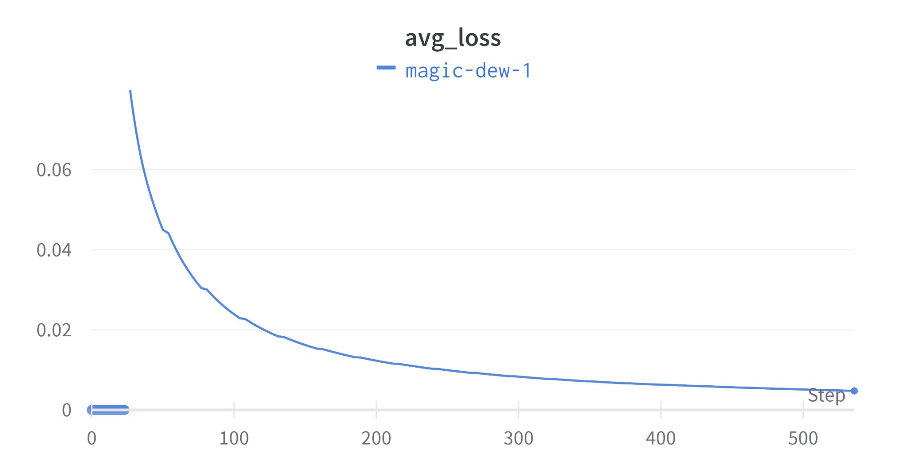
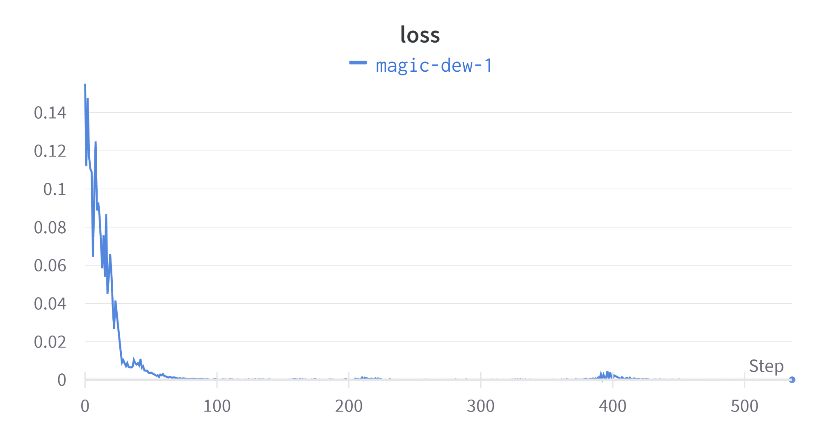
In-focus: Without 100 micron
Training Graphs

Slide 8
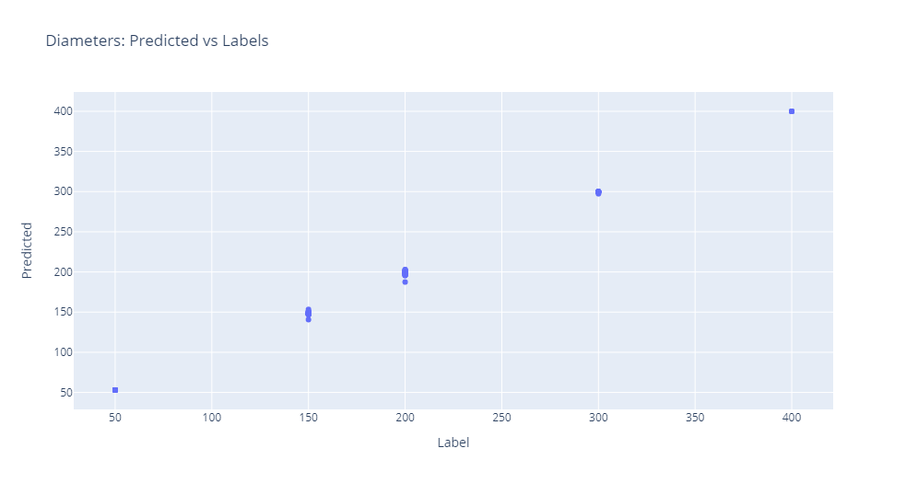
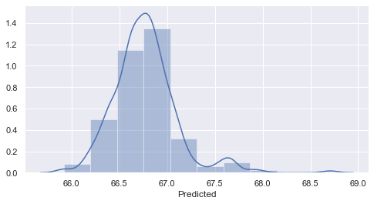
Distribution of predicted diameters of 100 micron droplets

Slide 9
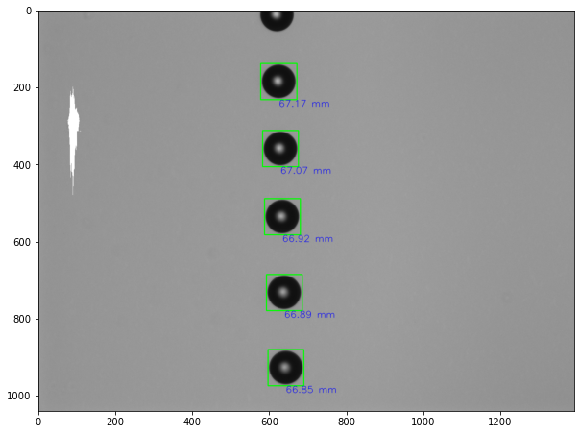
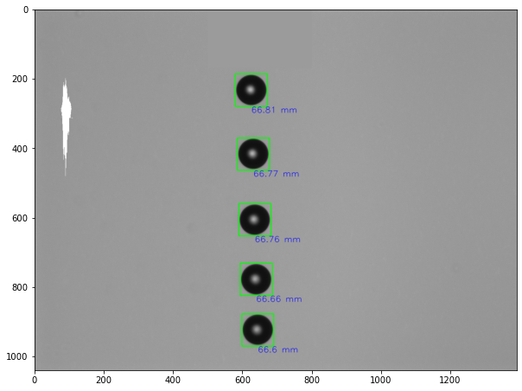
Sample outputs

Slide 10
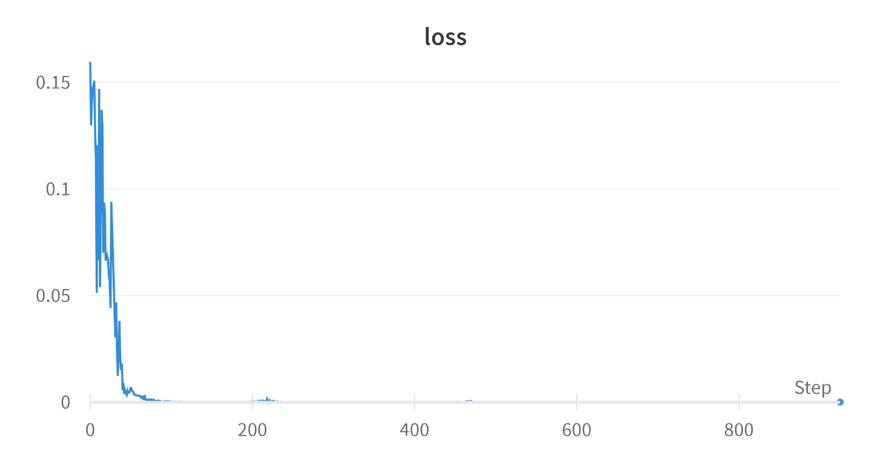
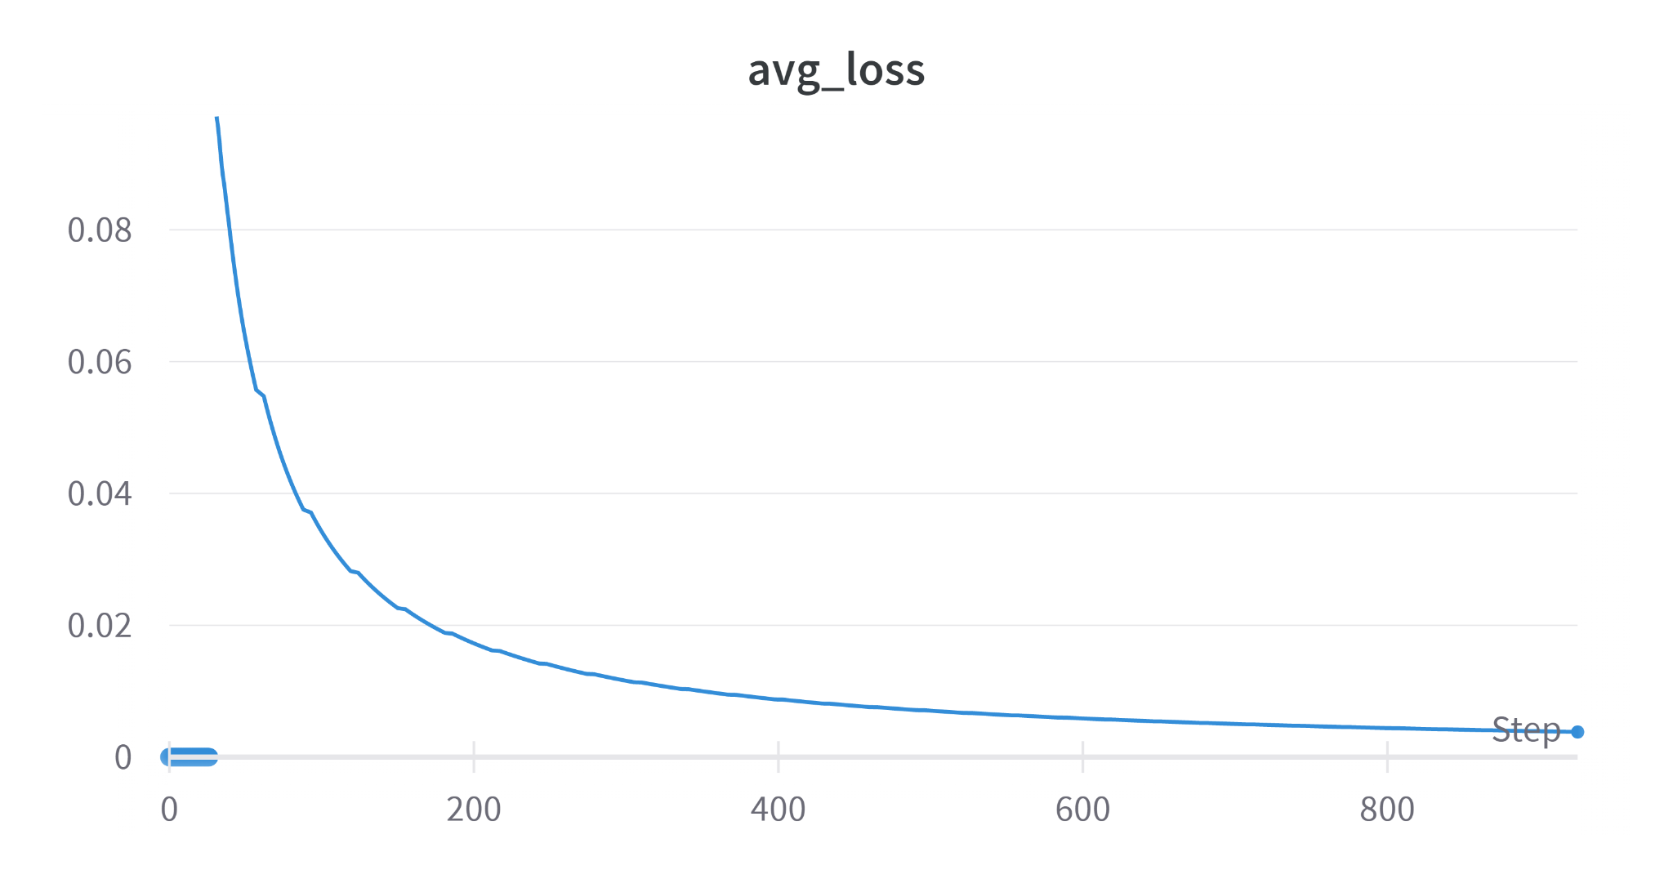
In-focus: Without 200 Micron
Training Graphs

Slide 11
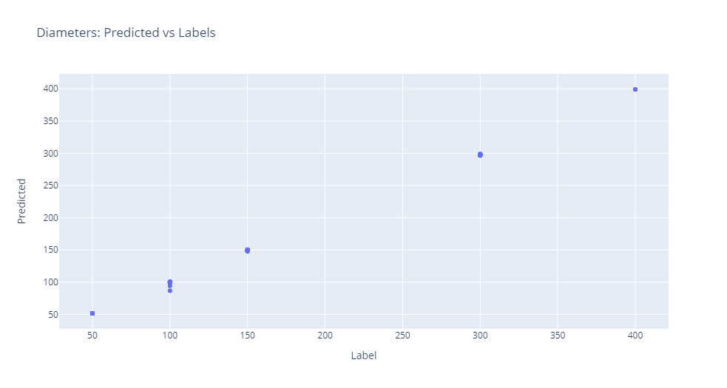
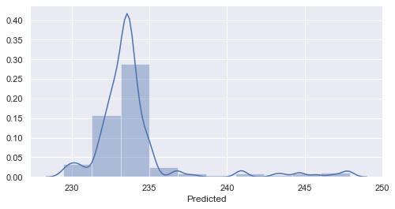
Distribution of predicted diameters of 200 micron droplets

Slide 12
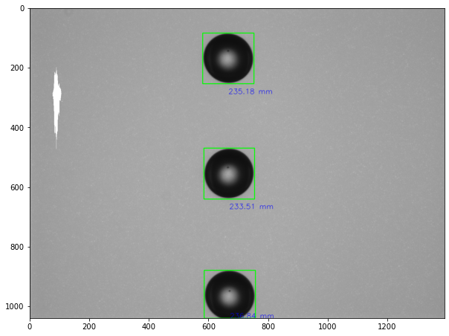
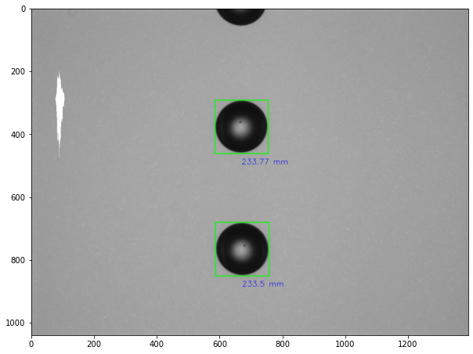
Sample outputs

Slide 13
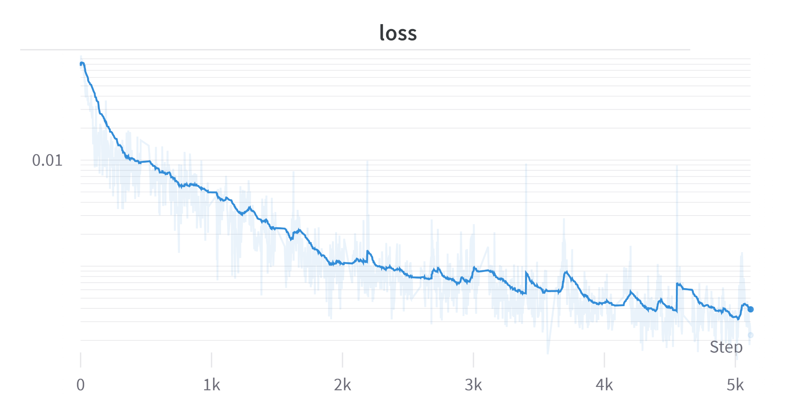
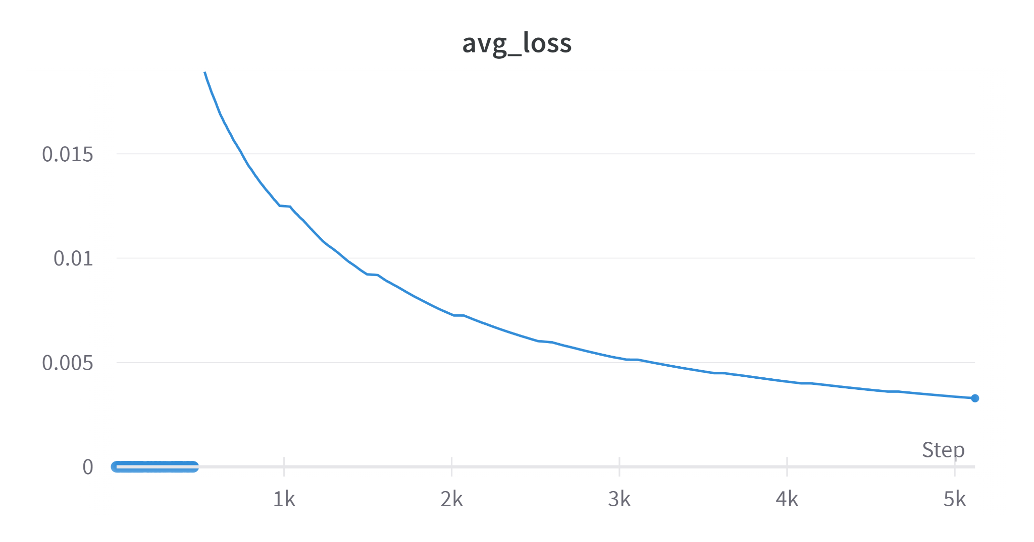
De-focus: All Diameters, 300mm range on both sides
Training Graphs

Slide 14
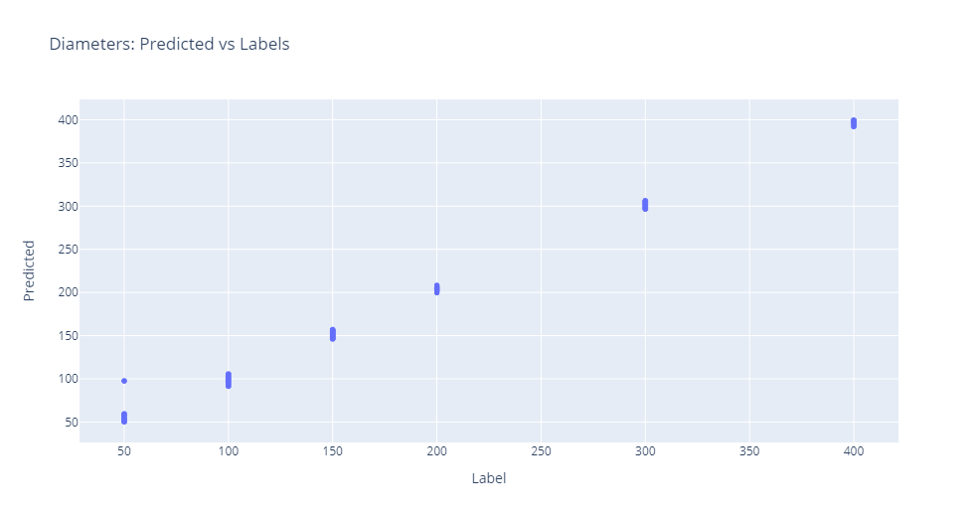
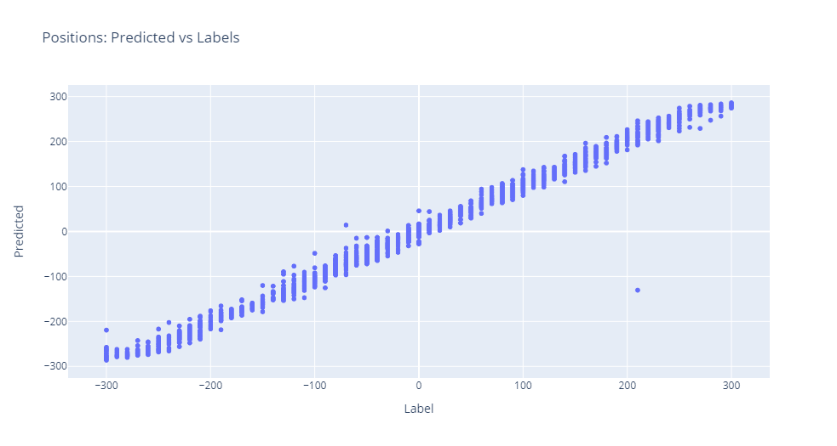

Slide 15
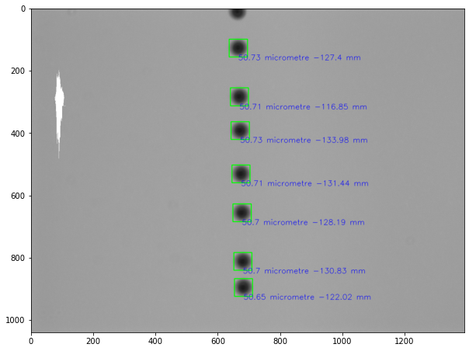
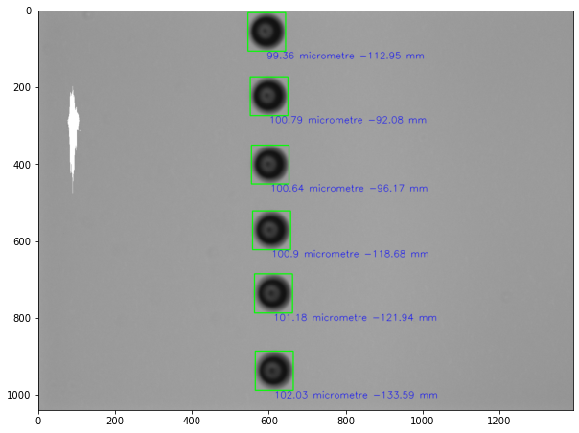
Sample outputs
50 micron, -110 mm
100 micron, -90 mm

Slide 16
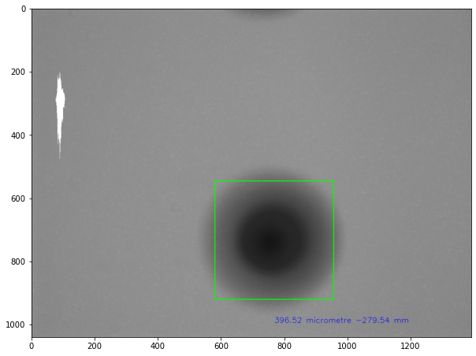
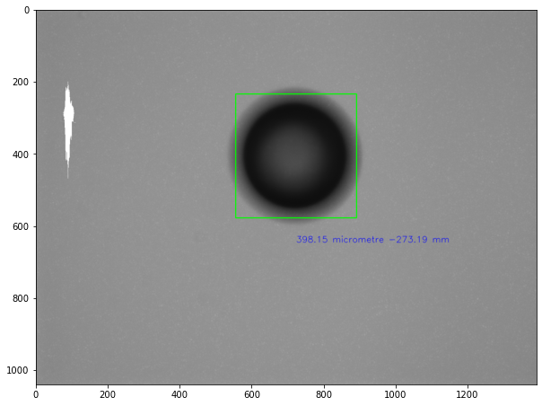
Sample outputs
400 micron, -740 mm
400 micron, -290 mm

Slide 17
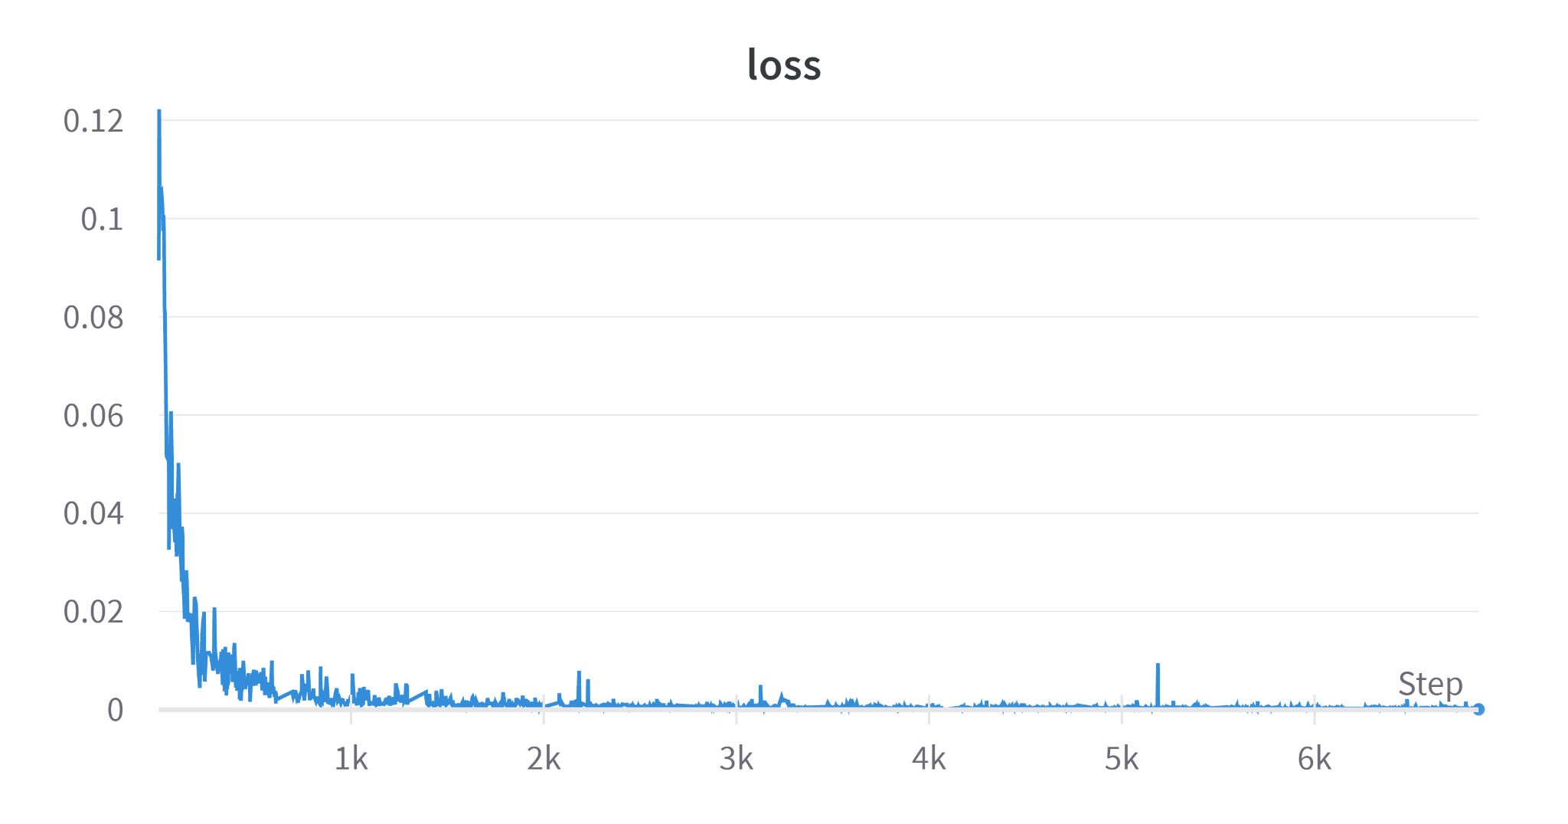
De-focus: Without 200 micron
Training Graphs

Slide 18
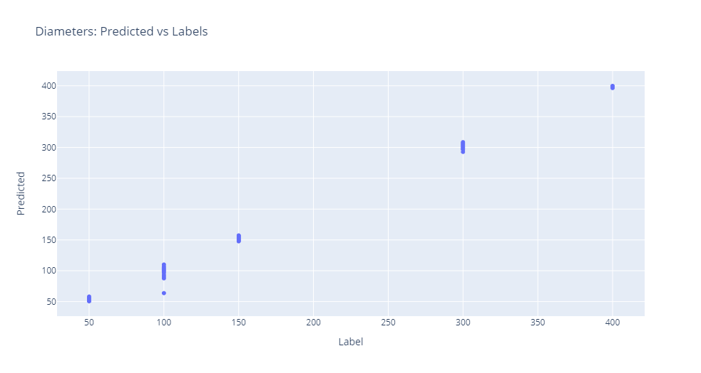
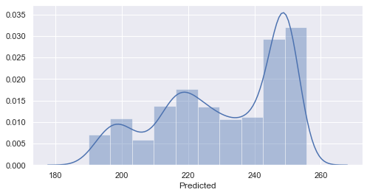
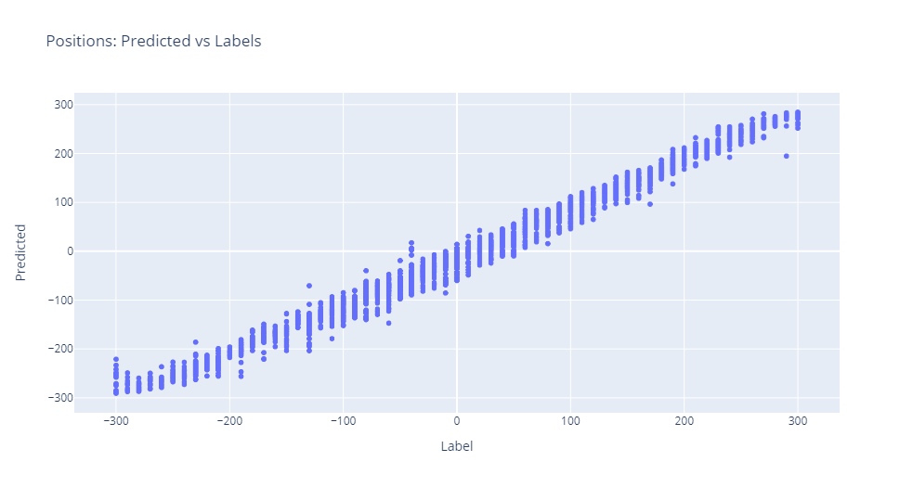
Distribution of predicted diameters of 200 micron droplets

Slide 19
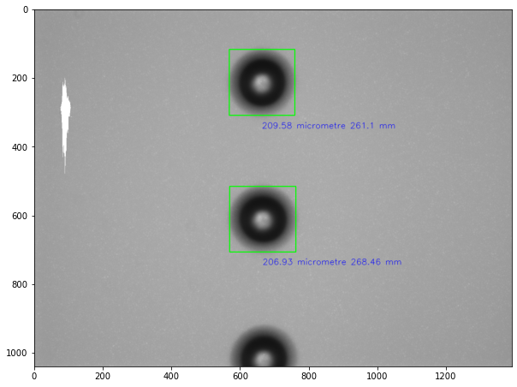
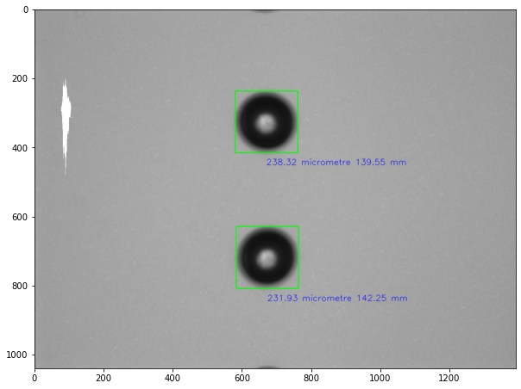
Sample outputs

Slide 20
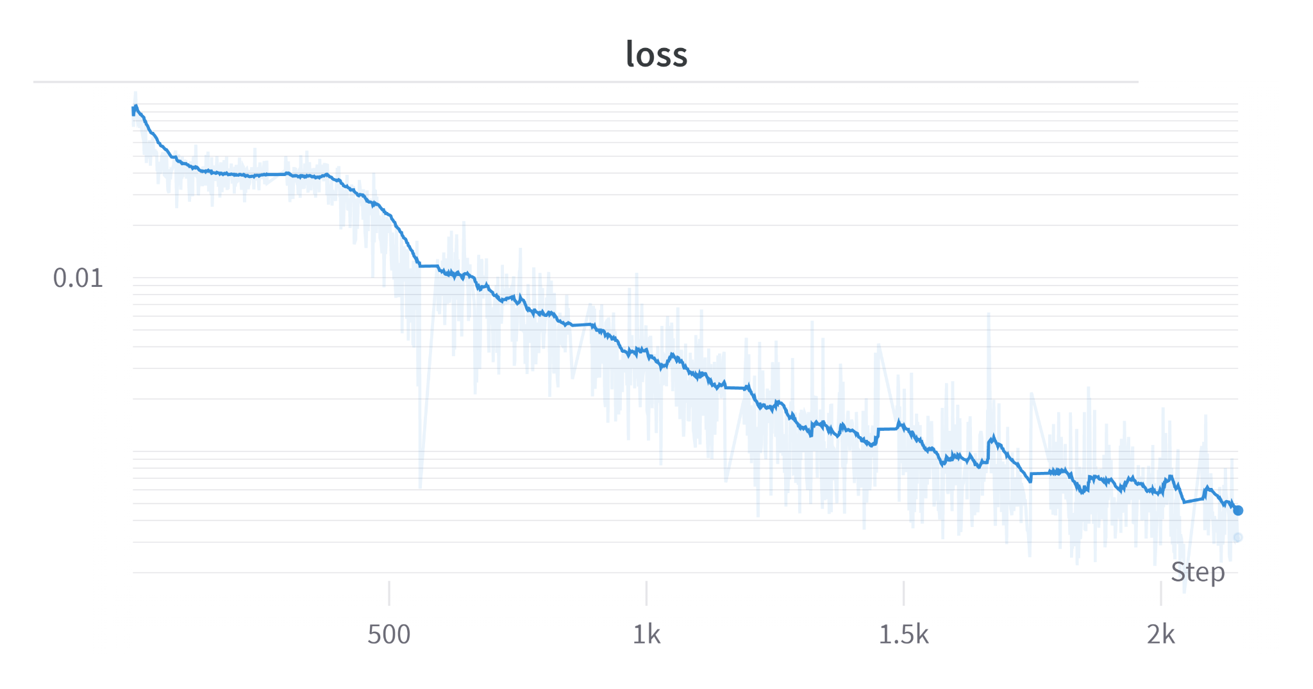
De-focus: Without 100 micron
Training Graphs

Slide 21
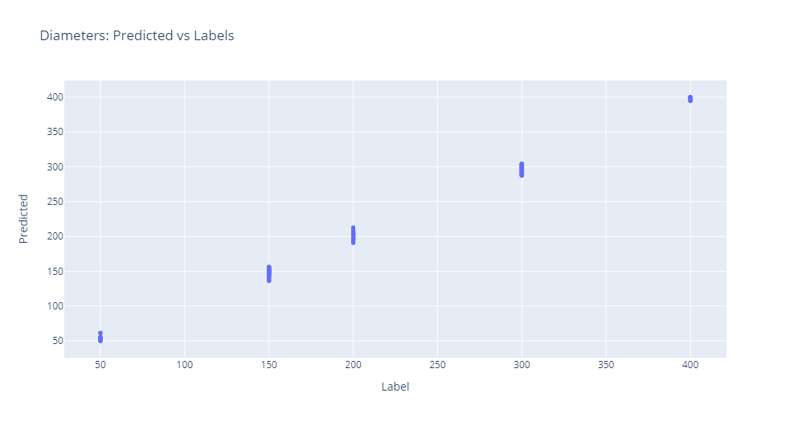
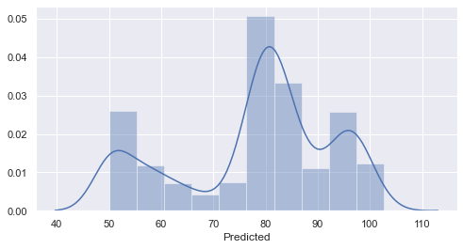
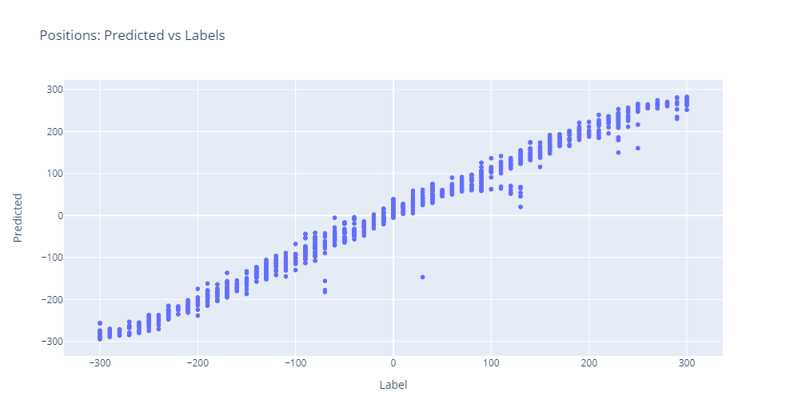
Distribution of predicted diameters of 100 micron droplets

Slide 22
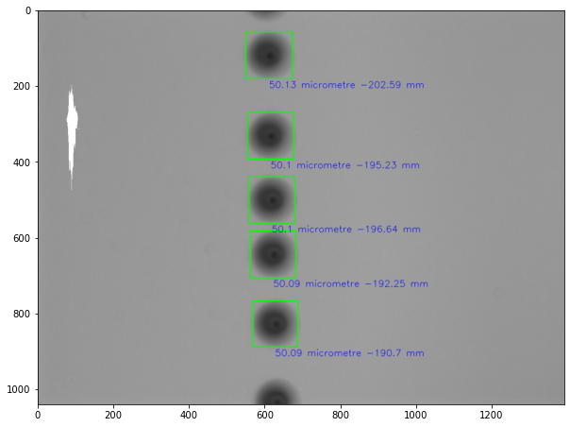
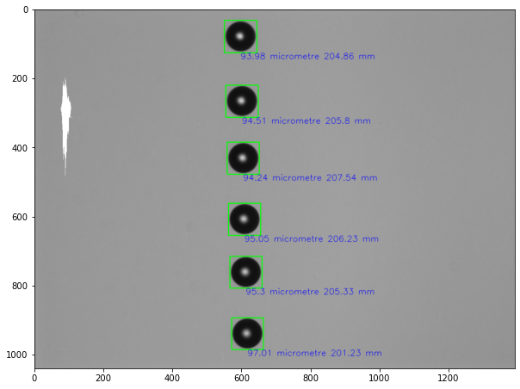
Sample outputs

Slide 23
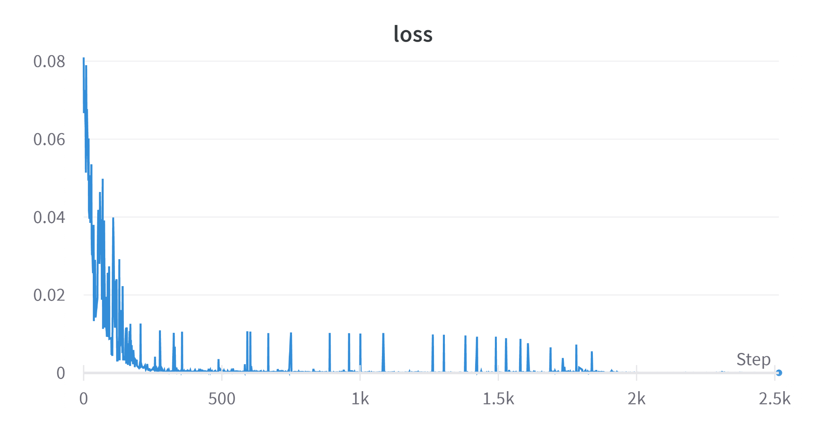
De-focus: Only 100 micron
Training Graphs

Slide 24
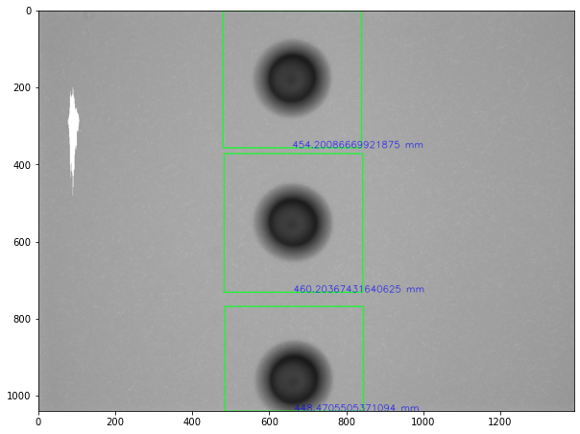
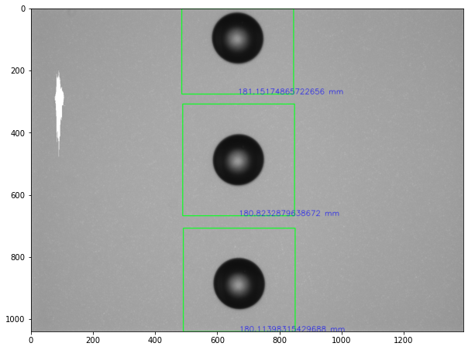
Sample outputs

